Slide 1

DEPARTMENT OF INFORMATION SCIENCE & ENGINEERING
“VEHICLE TALLY”
Presentation by,
NAME : Swaraj K S
USN : 1NH16IS113
Under the Guidance of ,
Guide Name : Mrs Divya
Designation :
Senior Assistant Professor

Slide 2
Agenda
Introduction
Problem Definition
Proposed system
Objectives
Design modules
Implementation
Demonstration of the project
Scope for Improvement
Conclusion

Slide 3
Introduction
In this software , a sample video of a road with moving vehicles is provided and allows the program to count the number vehicles passing across the road.
Vehicle counting has been developed using OpenCV via image pixel manipulation and calculation.
A real time vehicle counting is being developed which is simple and user friendly to keep a track on vehicles.

Slide 4
Problem Definition
To design and implement a software that counts the number of vehicles moving on a road and obtain the traffic data.

Slide 5
Objectives
The main motto of the project is to obtain the count of number of vehicles passing on the road using opencv.
To achieve the above objective with minimal expenditure and high accuracy.

Slide 6
Design Modules
Creating a frame: We give the all possible coordinates of all type of vehicles so as to make sure that all the vehicles in a particular video is traced with ease.
Accessing the input file: The video footage of any of the road is taken and is saved in the same folder where the program code is saved and the video file is accessed from the code.

Slide 7
Recognizing the vehicles: The vehicles passing on either side of the road is recognized based on the frame that is created.
Counting the vehicles: The number of vehicles passing on either side of the road is calculated separately for analyzing the traffic

Slide 8
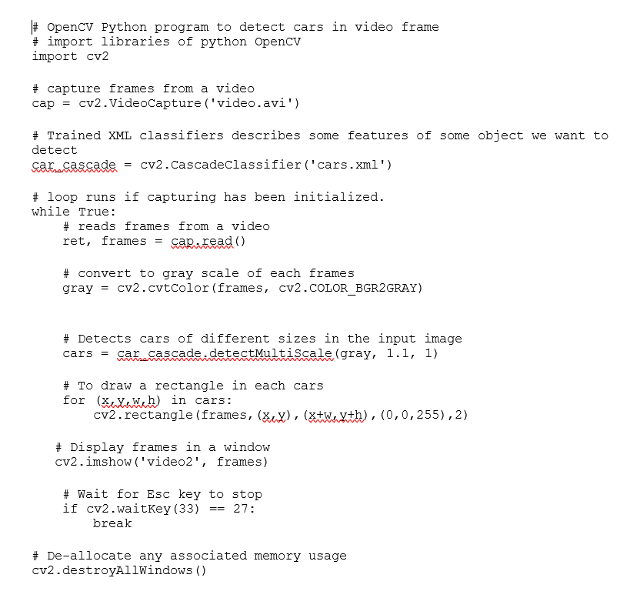
Implementations

Slide 9
Demonstration

Slide 10
Scope for Improvement
We can make the vehicle count in multiple videos.
Traffic management data can be added .

Slide 11
Conclusion
Day by day traffic in major cities is growing , the goal is to develop a software that allows us to analyse the roads and reduce traffic.
As this project keeps a track of the number of vehicles it can be used in the highway tolls for better management.
As this software does not use any hardware , it will be cost efficient and a simple approach for tracking the vehicles.

Slide 12
References
Real time traffic density measurement-Brac University
Stack Overflow-website

Slide 13
Thank you
Queries ?

Slide 14
Existing System
Right now the number of vehicles on road is calculated using a laser light.
It is also calculated using sensors such as acoustic, ultrasonic, infrared, magnetic inductive sensor.
Pneumatic Road tube counting, Inductive Loop are two other methods

Slide 15
Limitations
In almost all the methods the hardware tend to loose their accuracy in the long run.
The cost of implementing the previously mentioned methods are very high.
High maintenance cost.
Labour work is also extensive.

Slide 16
Status of the Project

